Slide 1
Artificial Intelligence
Lecture 19: Genetic Algorithms 1
Dr. Richard Spillman
PLU
Fall 2003

Slide 2


Class Topics
Future
NLP
Learning
Genetic
Algorithms
Expert
Systems
Genetic
Algorithms
Expert
Systems
Prolog
Learning
NLP
Intro to AI
Genetic
Algorithms
Lisp
Search
Search
Prolog
Intro to AI
Lisp

Slide 3
Last Class
Development of CLAM
Explanations
Introduction to Genetic Algorithms

Slide 4
Review – GA Process
Selection
Parents
Population
Crossover
Mutation
Offspring
Replacement

Slide 5
Outline
GA Structure
GA Operators
GA Applications
GA Examples

Slide 6
GA Structure

Slide 7
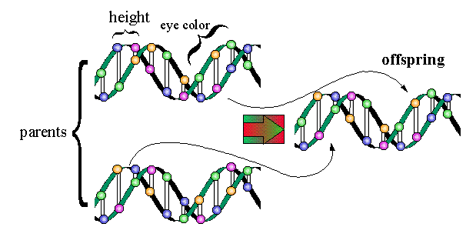
Genetic Concepts 1
A gene is a short length of a chromosome which controls a characteristic of an organism.
  The gene can be passed on from parent to offspring, e.g. a gene for eye-color.

Slide 8
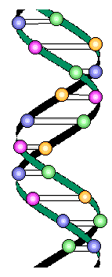
Genetic Concepts 2
A chromosome is a chain of genes
Each living object has a particular number of chromosomes, e.g. human beings have 46 chromosomes.

Slide 9
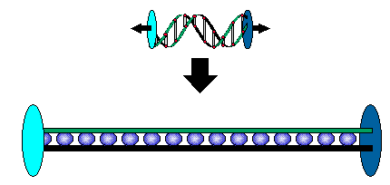
GA Structure (again)
Given a problem that in some way involves a search, a genetic algorithm begins with chromosome which represents a solution (usually a binary string).
Human Chromosome
Linear collection of bits (GA Chromosome)

Slide 10
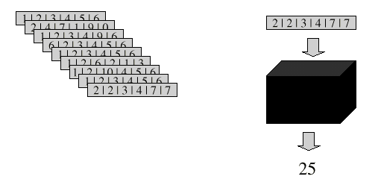
GA Components
Population - consists of individuals who may be able to solve the given problem
Fitness function – a function which determines how well each individual solves the problem

Slide 11
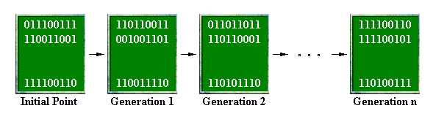
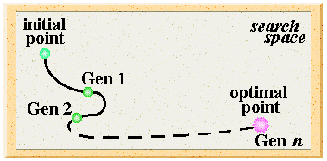
GA Process
GAs will cycle through populations of binary strings until a solution is found or a maximum number of generations have been created

Slide 12
GA Steps
A GA will implement the following:
generate a random population of n chromosomes
Selection
evaluate the “fitness” of each population element
Crossover
Mutation
randomly select two elements to serve as parents
combine the parents to create new solutions
randomly mutate the children

Slide 13
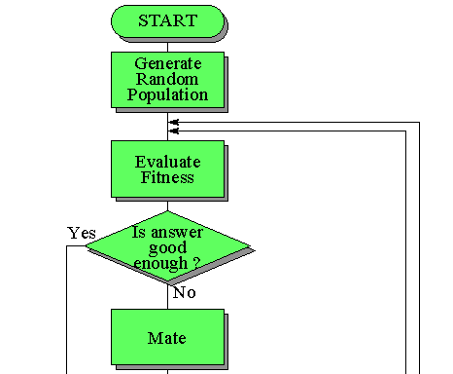
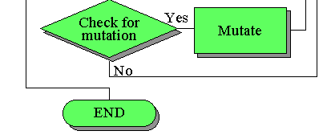
GA Flowchart

Slide 14

GA Operators

Slide 15
GA Operators
The features of a genetic algorithm which vary from implementation to implementation are:
representation scheme
Initial random population generation
method
Fitness Function
Parent Selection
Crossover Method
Mutation Method
We will look at these today

Slide 16
Parent Selection
The process in which individual strings in the population are selected to contribute to the next generation is called parent selection
  based on fitness
  strings with a high fitness have a higher probability of contributing one or more offspring to the next generation
Biased Roulette Wheel Selection
When you spin the wheel,
items 1 and 5 have the
greatest chance of coming up
while item 2 has the smallest
6
4
1
3
2
5

Slide 17
Example
Given the following population of chromosomes, select two parents:
Chromosome Fitness
% fitness
cf
(1 0 1 0 0 1) 23
0.28
0.28
(1 1 1 0 0 1) 12
0.15
0.43
(0 1 1 0 1 1) 25
0.30
0.73
(0 1 0 1 1 0) 5
0.06
0.79
(0 1 1 0 1 0) 17
0.21
1.00
Total Fitness 82
Find the total fitness of the population
Now, throw a random number between 0 and 1, if it is
in the range 0 to 0.28 select element 1, between 0.28 and 0.43
select element 2, . . .
Find the %fitness of each element
Find the cumulative fitness

Slide 18
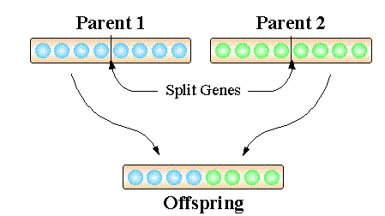
Crossover
Once two parents are selected, their chromosomes are mixed to create the children for the next generation
Called single point crossover

Slide 19
Example
Assume the parents selected from the previous example are:
(1 0 1 0 0 1) (0 1 1 0 1 0)
(1 0 1 0
1 0)
(0 1 1 0
0 1 )
These are the two children which
are now part of the next generation
Find a random crossover point
Swap the bits after the crossover point

Slide 20
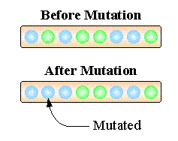
Mutation
A bit in a child is changed (from 1 to 0 or from 0 to 1) at random
This is a small probability event
The effect is to prevent a premature convergence
to a local minimum or maximum

Slide 21
GA Performance
Increasing diversity by genetic operators
  mutation
  Recombination
Decreasing diversity by selection
  of parents
  of survivors

Slide 22
GA Applications

Slide 23
GA Applications
Numerical, Combinatorial Optimization
System Modeling and Identification
Planning and Control
Engineering Design
Data Mining
Machine Learning
Artificial Life

Slide 24
Evaluation
Acceptable performance at acceptable costs on a wide range of problems
Intrinsic parallelism (robustness, fault tolerance)
Superior to other techniques on complex problems with
  lots of data, many free parameters
  complex relationships between parameters
  many (local) optima

Slide 25
Advantages
No presumptions w.r.t. problem space
Widely applicable
Low development & application costs
Easy to incorporate other methods
Solutions are interpretable (unlike NN)
Can be run interactively, accomodate user proposed solutions
Provide many alternative solutions

Slide 26
Disadvantages
No guarantee for optimal solution within finite time
Weak theoretical basis
May need parameter tuning
Often computationally expensive, i.e. slow

Slide 27
GA Examples

Slide 28
GA Example 1
Problem: Find the maximum value of a two variable function
F(x₁,x₂) = 21.5 + x₁sin(4πx₁) + x₂sin(20πx₂)
x₁ is in the range [-3.0,12.1] and
x₂ is in the range [4.1,5.8]
There are several ways to solve this
problem: Classical/Search/GA . . .

Slide 29
Representation
The first problem is one of representation
  how do you create a binary representation of a real number?
SOLUTION: determine a level of precision and divide the range into equal sized intervals
  if p is the level of precision and the interval is L then the number of bits required is the number of bits in the binary representation of L x 10^{p}
    for x₁ the interval is -3 to 12.1 so L = 15.1
      1 decimal place of precision requires 8 bits (15.1 x 10¹)
      2 decimal places of precision require 11 bits (15.1 x 10²)

Slide 30
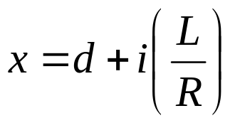
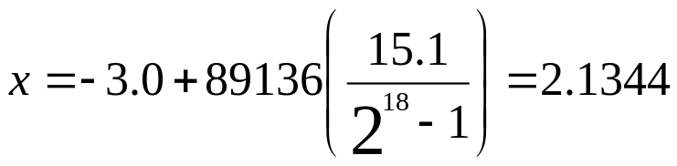
Conversion
To convert a binary number b to a real number x use:
Where
i is the integer value of b
d is the lower value of the range
L is the length of the range
R is the range of binary integers
For example, x₁ with 4 digits of precision (18 bits), is found
to be (in binary): 010101110000110010
i is 89136
L is 15.1
R is 2¹⁸-1
d is -3

Slide 31
Complete Representation
x₂ has a range of 1.7, so for 4 decimal places of precision it requires 15 bits
Hence, a single chromosome for both variables requires 18 + 15 = 33 bits
  the first 18 bits represent x₁
  the last 15 bits represent x₂
For example, this chromosome represents two real numbers
<010001001011010000111110010100010>
x₁ = 1.0524 x₂ = 5.7553

Slide 32
Start a GA
Determine a population size, n
Using a random number generator, construct n binary strings
Determine the fitness of each random solution

Slide 33
Example Run
Point Binary Representation Value
v₁ 100110100000001111111010011011111 26.0196
v₂ 111000100100110111001010100011010 7.5800
v₃ 000010000011001000001010111011101 19.5263
v₄ 100011000101101001111000001110010 17.4067
v₅ 000111011001010011010111111000101 25.3411
v₆ 000101000010010101001010111111011 18.1004
v₇ 001000100000110101111011011111011 16.0208
v₈ 100001100001110100010110101100111 17.9597
v₉ 010000000101100010110000000101100 16.1277
v₁₀ 000001111000110000011010000111011 21.2784
v₁₁ 011001111110110101100001101111000 23.4106
v₁₂ 110100010111101101000101010000000 15.0116
v₁₃ 111011111010001000110000001000110 27.3167
v₁₄ 010010011000001010100111100101001 19.8762
v₁₅ 111011111011100001000111110111110 30.0602
v₁₆ 110011110000011111100001101001011 23.8672
v₁₇ 011010111111001111010001101111101 13.6961
v₁₈ 011101000000001110100111110101101 15.4142
v₁₉ 000101010011111111110000110001100 20.0959
v₂₀ 101110010110011110011000101111110 13.6669
Population size is 20,
fitness is the function
value
Best Element (so far)

Slide 34
Parent Selection
To set up a roulette wheel selection process, you need to find:
  the total fitness (in this case, F = 387.7768)
  the percentage fitness of each chromosome
    divide its fitness by F
  the cumulative fitness
Note that the average fitness for this initial random population is 19.39

Slide 35
Example
Percentage Cumulative
v₁ 0.067099 0.067099
v₂ 0.019547 0.086647 (0.067099 + 0.019547)
v₃ 0.050355 0.137001 (0.086647 + 0.050355)
v₄ 0.044889 0.181890
v₅ 0.065350 0.247240
v₆ 0.046677 0.293917
v₇ 0.041315 0.335232
v₈ 0.046315 0.381546
v₉ 0.041590 0.423137
v₁₀ 0.054873 0.478009
v₁₁ 0.060372 0.538381
v₁₂ 0.038712 0.577093
v₁₃ 0.070444 0.647537
v₁₄ 0.051257 0.698794
v₁₅ 0.077519 0.776314
v₁₆ 0.061549 0.837863
v₁₇ 0.035320 0.873182
v₁₈ 0.039750 0.912932
v₁₉ 0.051823 0.964756
v₂₀ 0.035244 1.000000
Throw a random number
between 0 and 1, say 0.51387
Throw another random
number, say 0.175741

Slide 36
Crossover
Select two random parents
Using the preset probability of a crossover, p_{c}, throw a random number, r.
  if r < p_{c} then perform a crossover operation on the two parents
  otherwise pass both parents on to the next generation
Repeat this process until the next generation is full

Slide 37
Example
If v₂ and v₁₁ are selected as parents and a random number determines the crossover point is 9, then:
v₂ 100011000101101001111000001110010
v₁₁ 111011111011100001000111110111110
c₁ 100011000011100001000111110111110
c₂ 111011111101101001111000001110010

Slide 38
Mutation
As each chromosome is added to the next generation, it is examined bit by bit
  each time a bit is examined, a random number is thrown, r
  if r < P_{m} then that bit is complemented otherwise it is left unchanged
The whole cycle begins again - it will stop when either a solution is found or the maximum number of generations have been produced

Slide 39
Possible Quiz
Remember that even though each quiz is worth only 5 to 10 points, the points do add up to a significant contribution to your overall grade
If there is a quiz it might cover these issues:
  Describe a crossover operation.
  How is mutation done?
  What are the three major steps in a GA?

Slide 40
Summary
GA Structure
GA Operators
GA Applications
GA Examples

